Slide 1
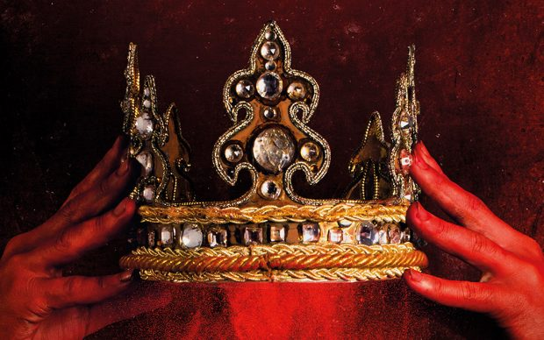
MACBETH
PRESENTAZIONE 4AFM1

Slide 2
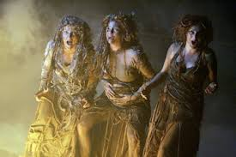
Christine B.
I like this picture because the characters I liked best were the witches: they were threatening and very funny at the same time.
I sometimes feel like them because I am a bit crazy!!

Slide 3
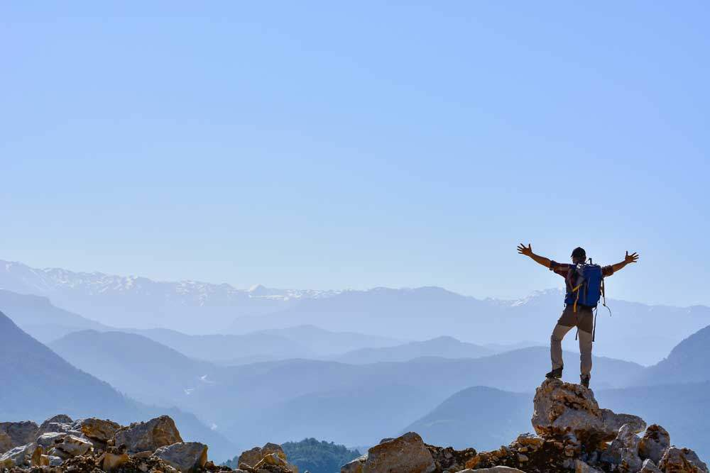
Angelo C.
With this image I want to describe the determination and the strength that good characters showed in defeating bad characters in “MACBETH”. Thanks to their courage the good ones succeed in defeating Macbeth. I think that Macbeth was very decisive , but the witches misled him and he lost everything.

Slide 4
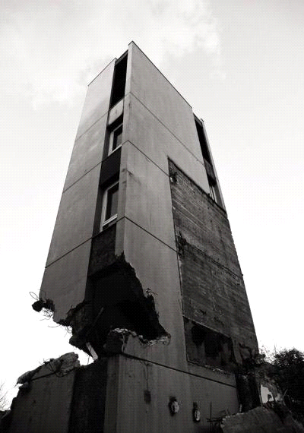
Sharon C.
I think Macbeth's mind is similar to a building whose foundations have been destroyed. Macbeth and Lady Macbeth destroy the most important thing in life, their moral values - their “foundations”-.
Macbeth prefers power to family bonds and friendship. Actors were very good : even if I didn't understand much, I could enjoy the tragedy. The skills of the actors made me feel as if I myself took part in the story.
I have learnt that wealth and power are not enough to lead a happy life.

Slide 5
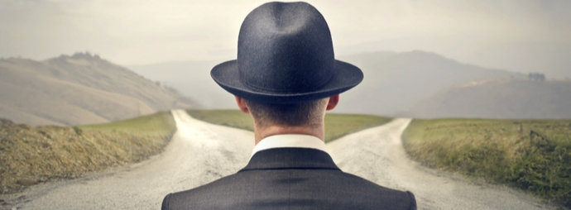
Gloria C.
During the play I had two opposite feelings.
On one hand I felt well, because I understood what was happening on the stage and who the characters were since we had studied the plot in English.
On the other, I felt a bit frustrated: I had difficulties in understanding what the actors were saying.
However I liked this activity and I think it was a good exercise for us. Moreover the actors were really good.

Slide 6
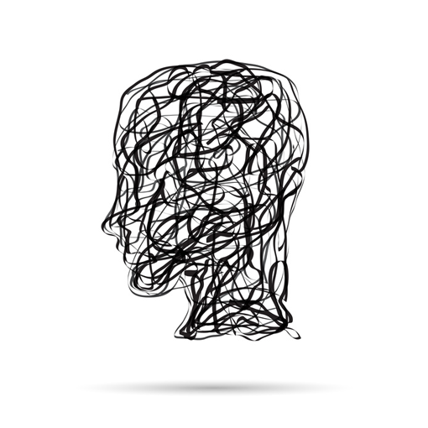
Giulia D.P.
The image shows my confusion: the actors acted very well but they talked too fast and I couldn't understand well.
I understood only a few words.

Slide 7
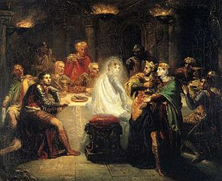
Yacine G.
I have chosen this picture because I liked it very much when the king is almost driven crazy when Banco’s ghost appears! This scene shocked me a lot.

Slide 8
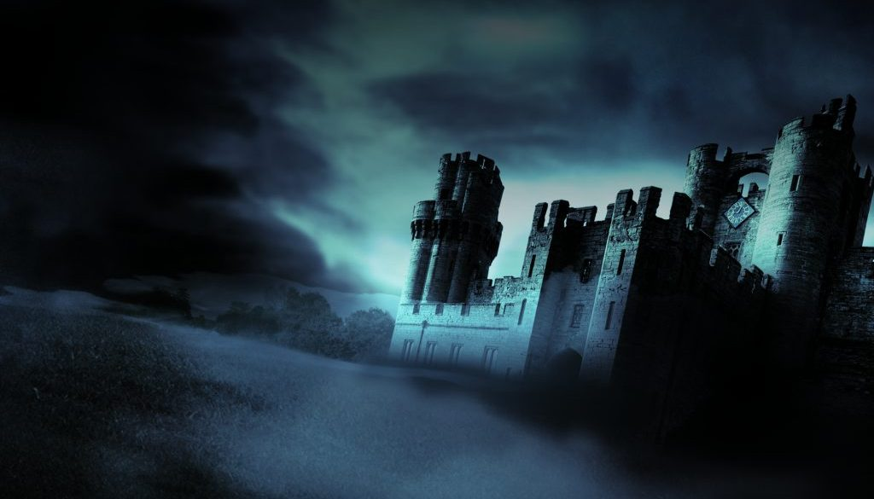
Luca M.
The play was very enjoyable and the actors were true professionals. It was so touching that I felt like I was in Scotland all play long. The characters raised a lot of emotions that, in my opinion, were important to explain their role in the plot and to make you feel part of the play. In the end I could understand all of the scenes and I think that the tragedy was faithful to the original Macbeth.

Slide 9
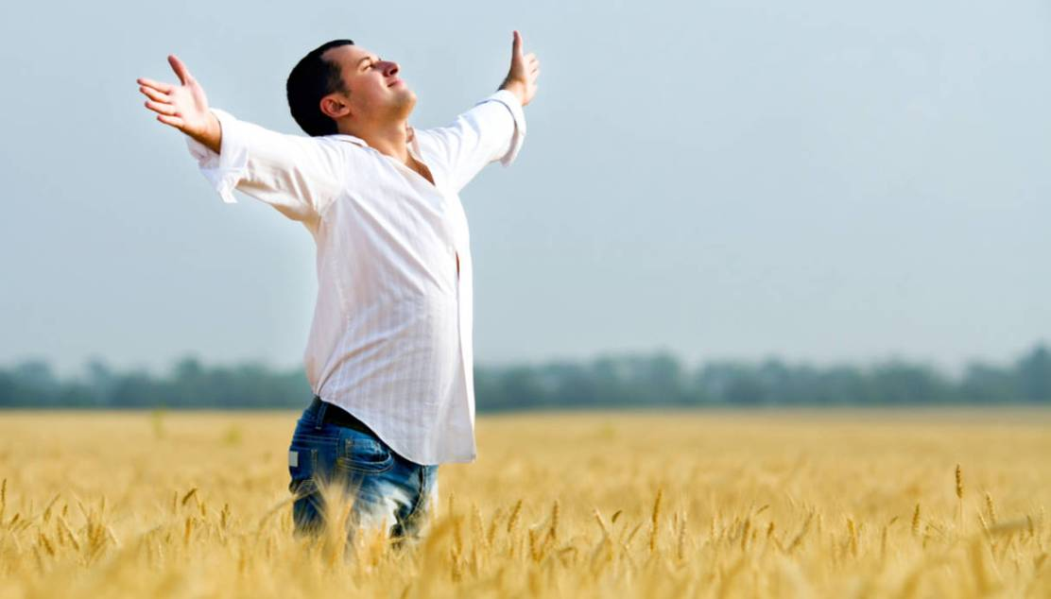
Iran P.
Happiness is …..having understood almost all the play

Slide 10
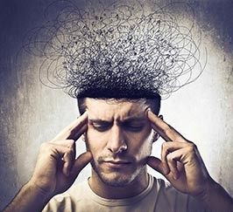
Eleonora T.
I didn't understand all the words but I succeeded in understanding the plot of this tragedy.
Moreover I was confused by a lot of scenes because they weren’t an help but a distraction.
However the play was pleasant.

Slide 11
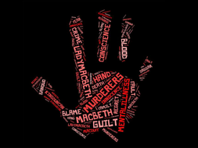
Camilla T.
This play was surprising.
Knowing that «Macbeth» was a tragedy, I expected dark settings and colours and gothic elements.
Even if the settings were extremely simple, you could easily understand what was going on
Some funny and comic scenes contrasted with murders and war scenes
I think that the actors were amazing, they were able to act more than one characters at the same time in the same brilliant way.

Slide 12
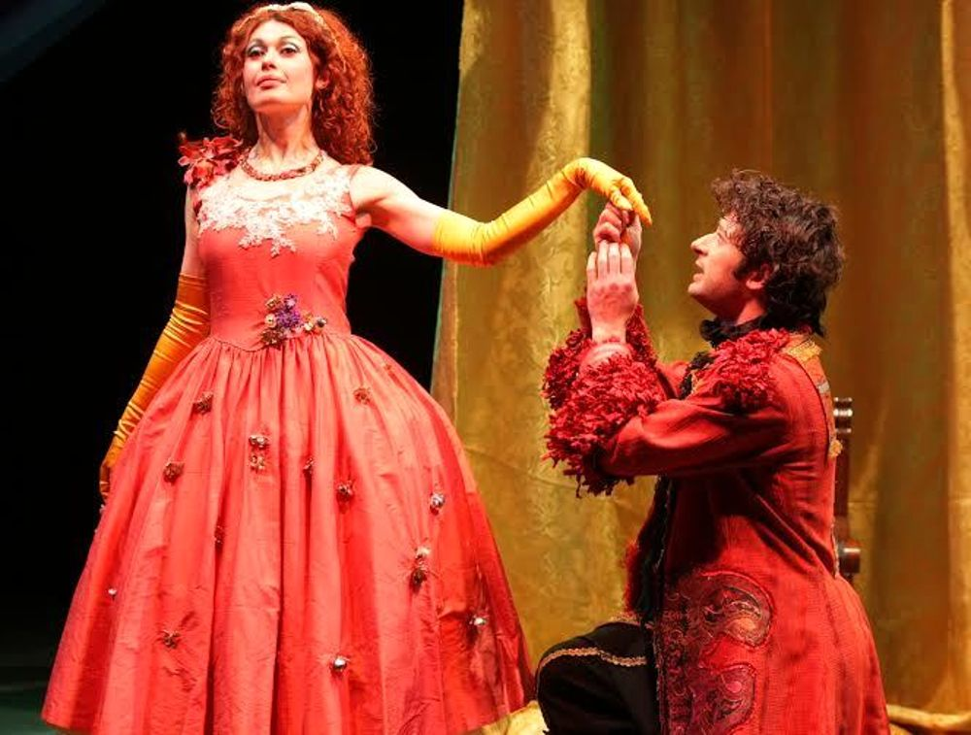
Mattia V.
I like this image because I saw that Lady Macbeth was the one who had power in her hand. Usually at that time the power was held by the king and he ruled over his realm. In the play Macbeth is actually wearing the crown but it’s Lady Macbeth who is got the power. She is the mastermind of any murder and the one who makes decisions.

Slide 13
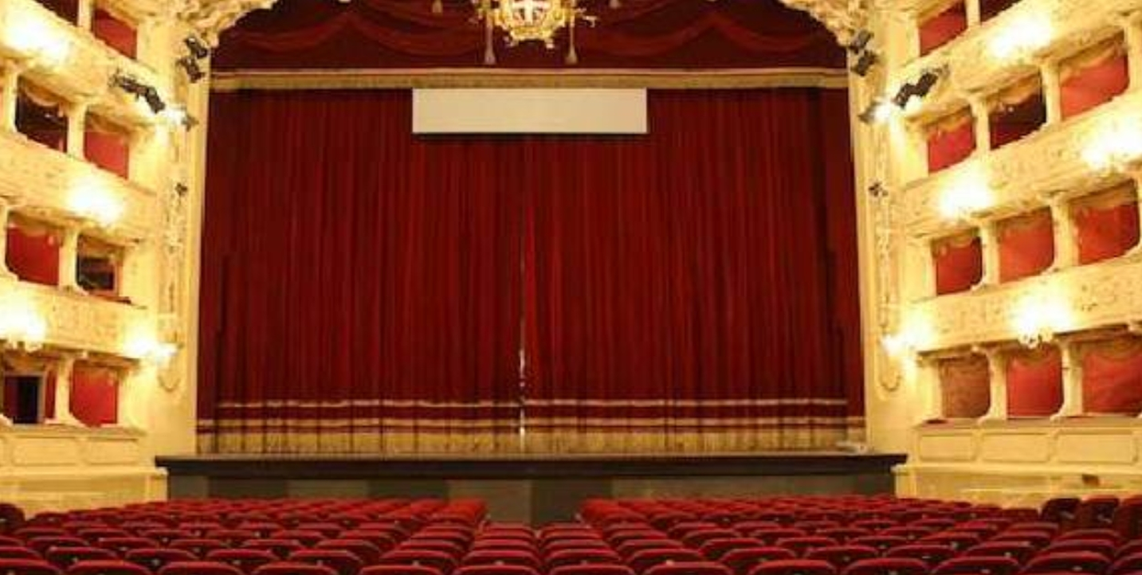
Vittorio V.D.
I have chosen this image because I noticed how different it is to be told a story and to see the same story performed on the stage by good actors.
I didn’t understand much but I liked being in a theatre.

Slide 14
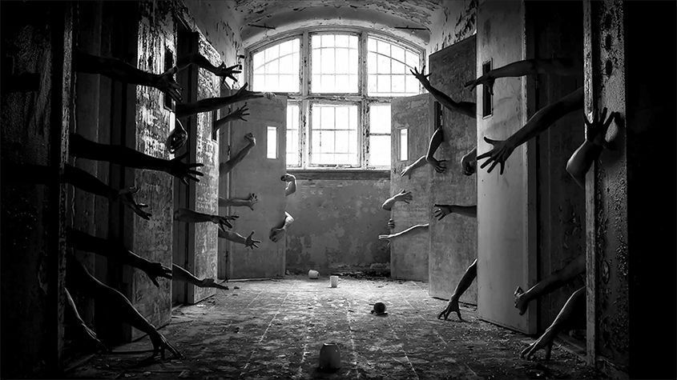
Maged Z.
In some scenes I felt as if I were in an asylum

Slide 15
THE END

